Slide 1

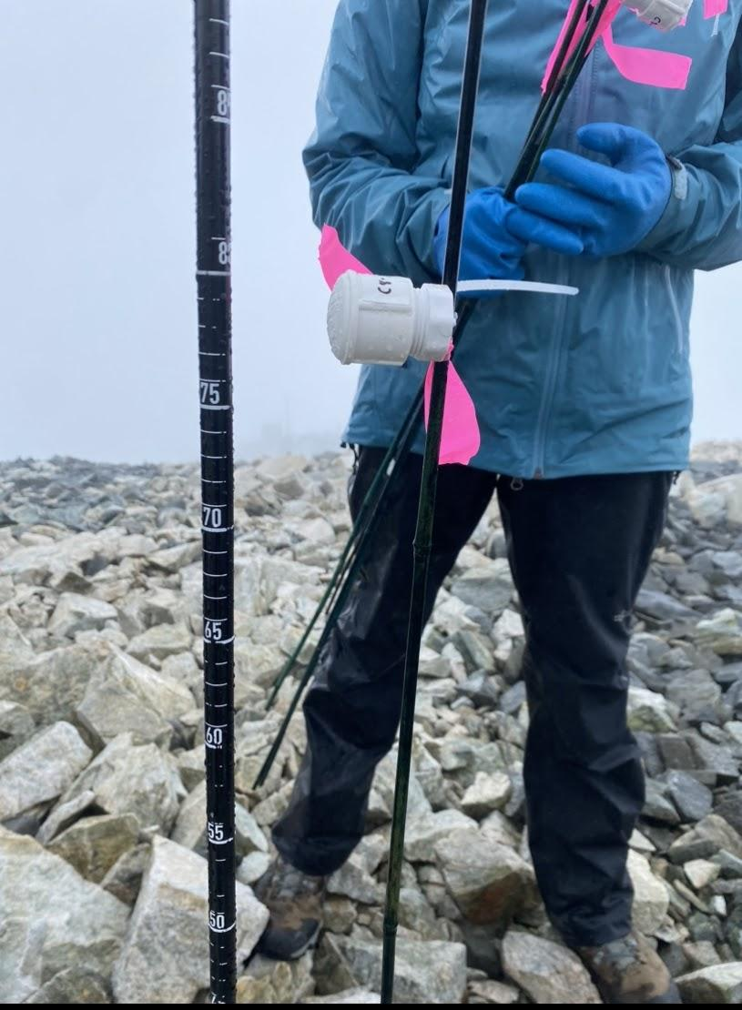
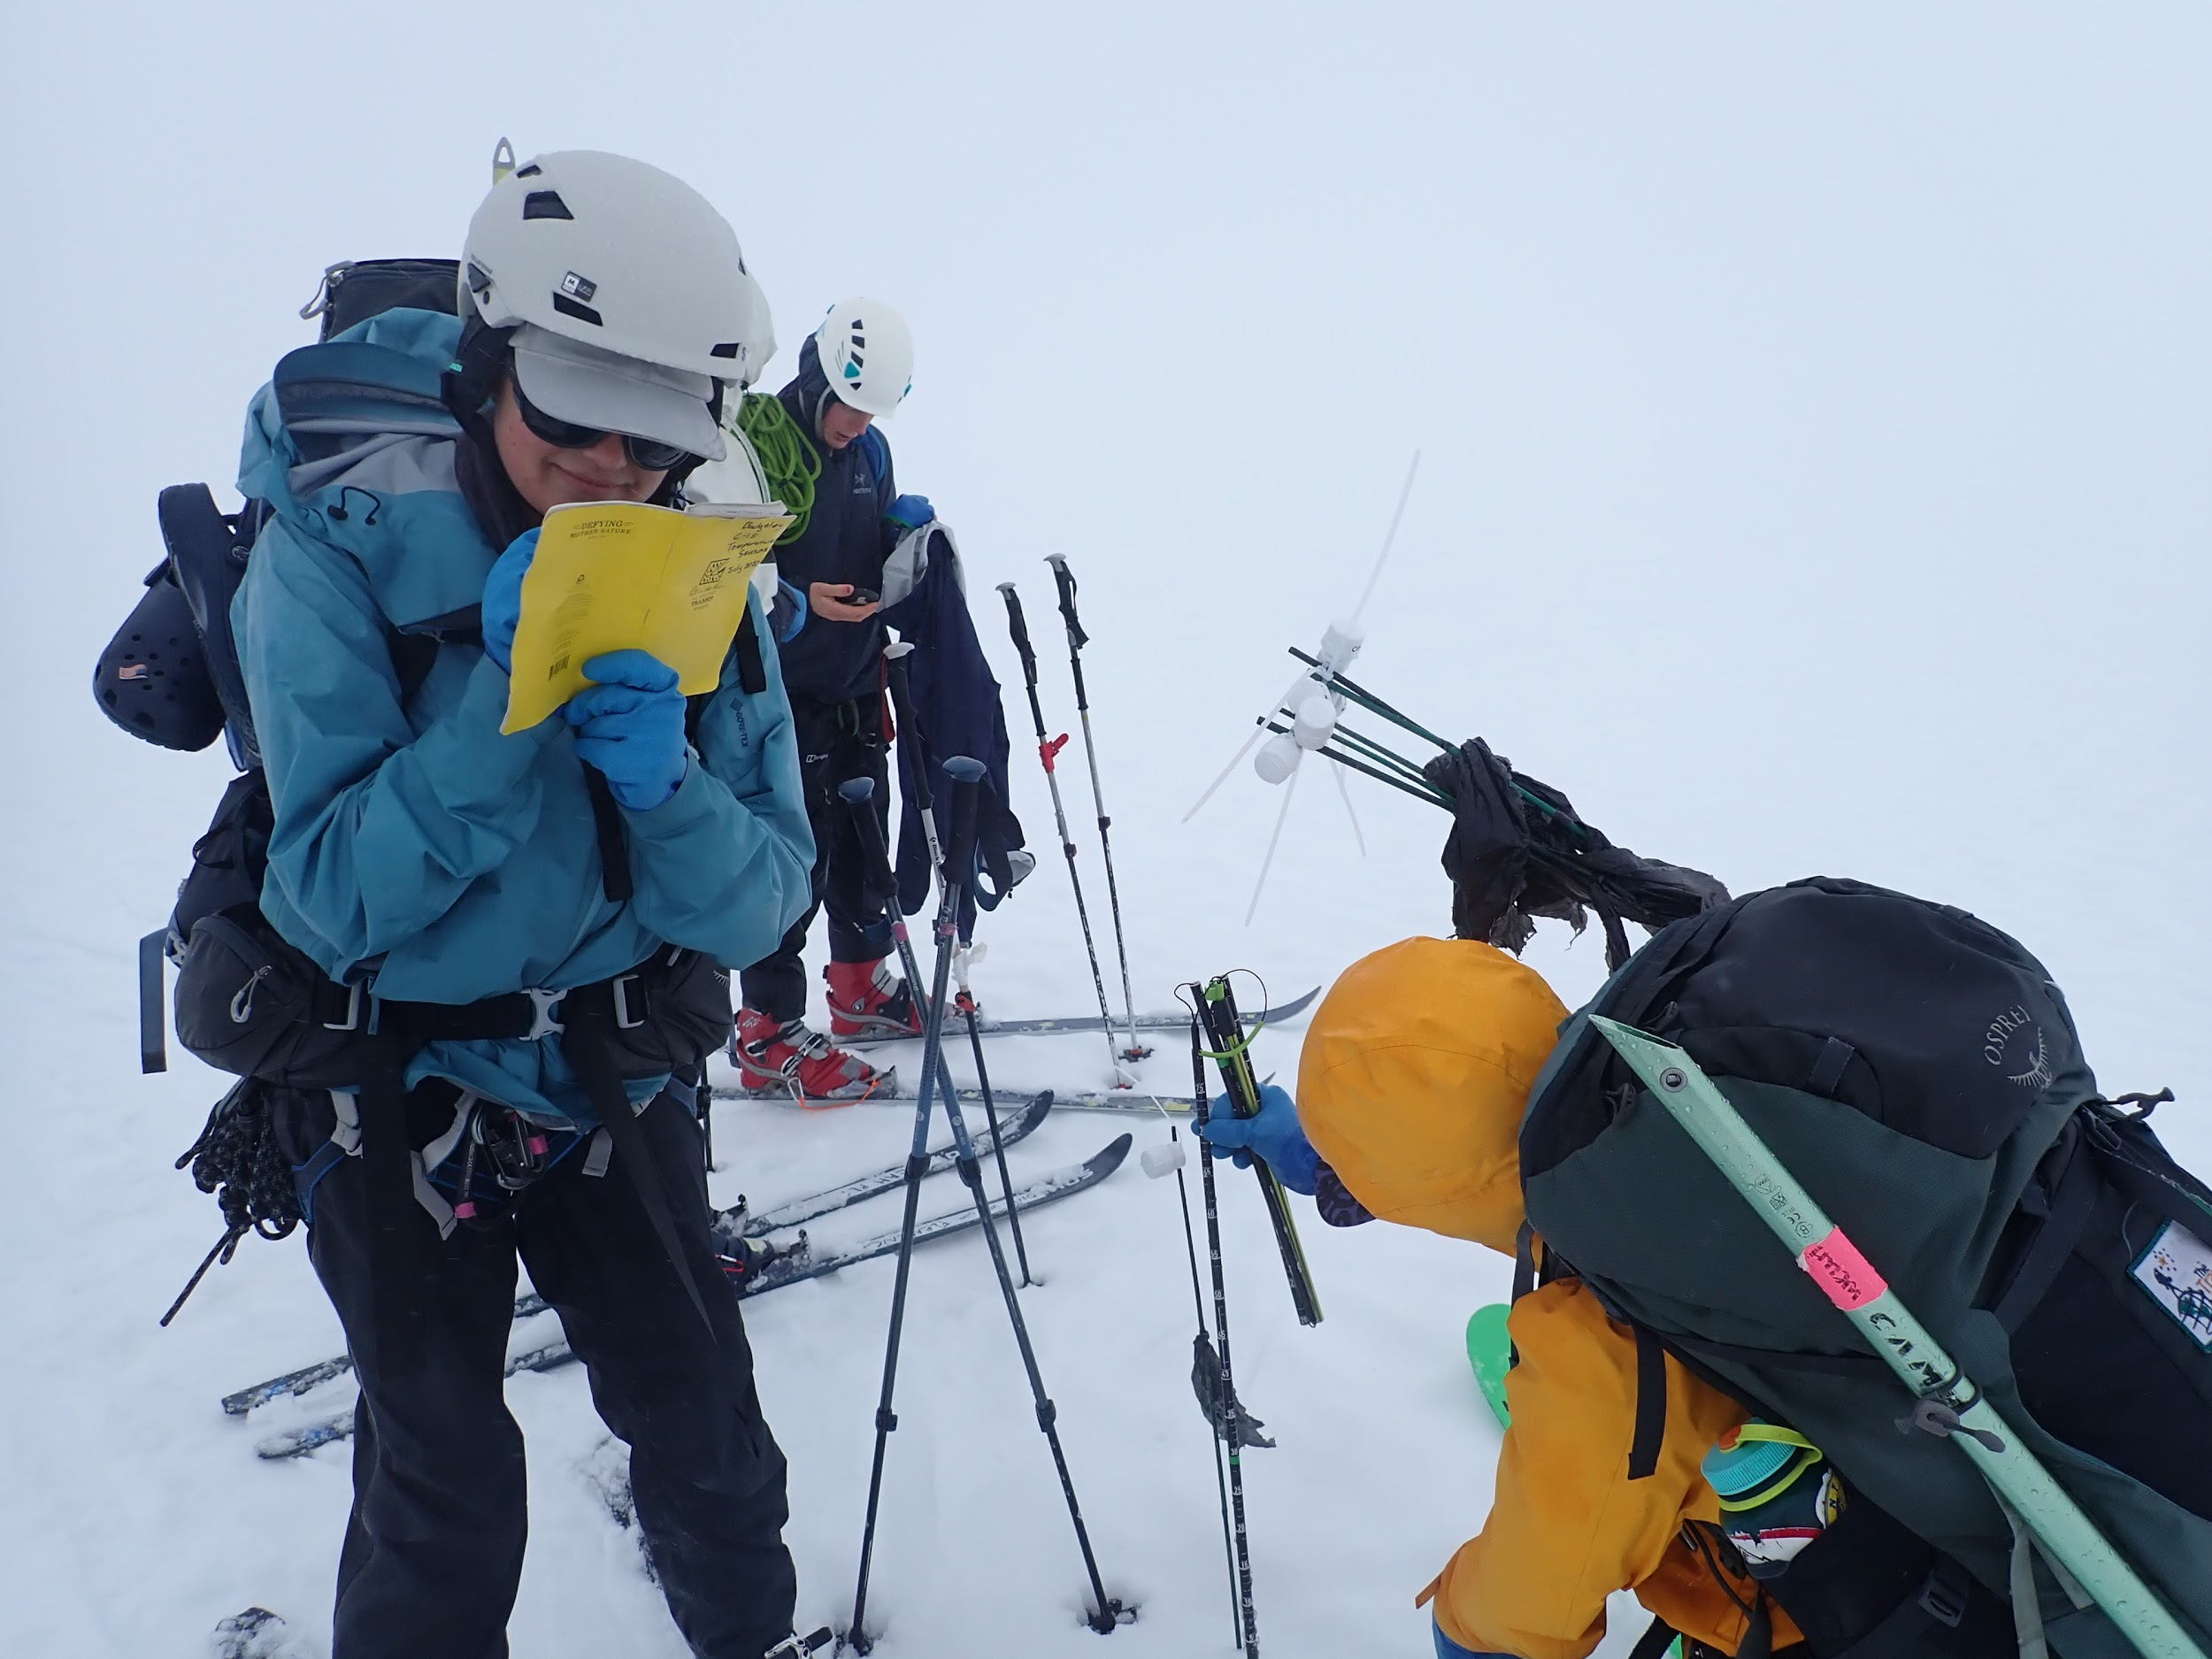
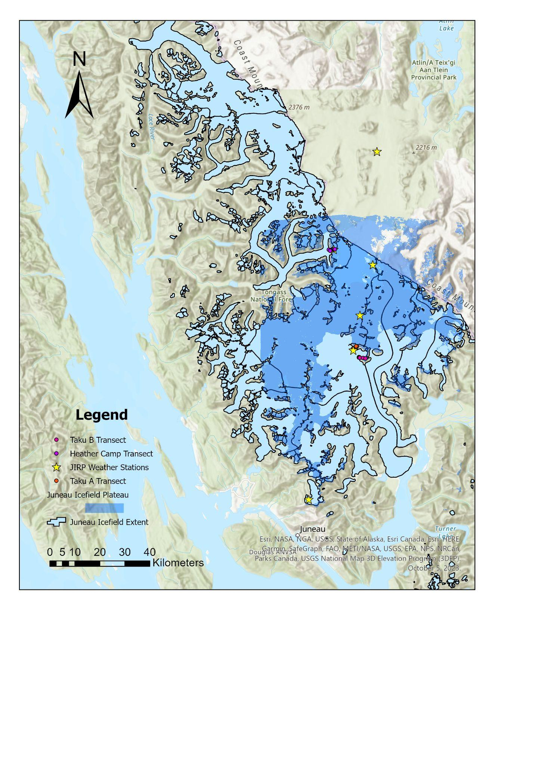
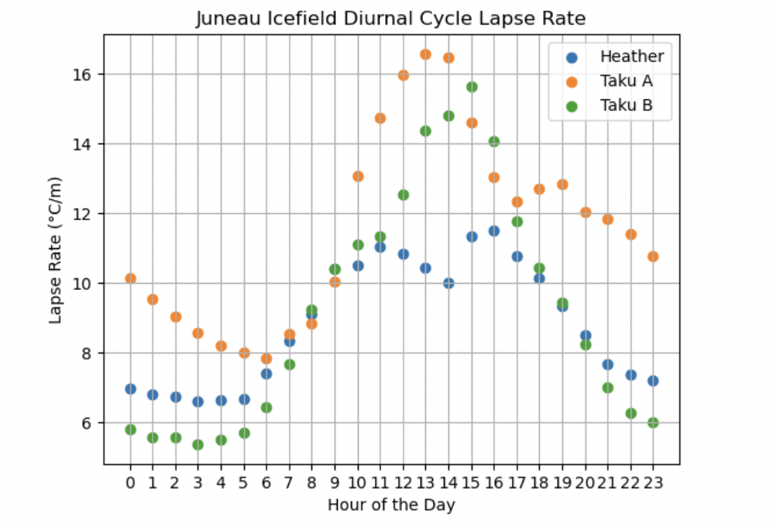
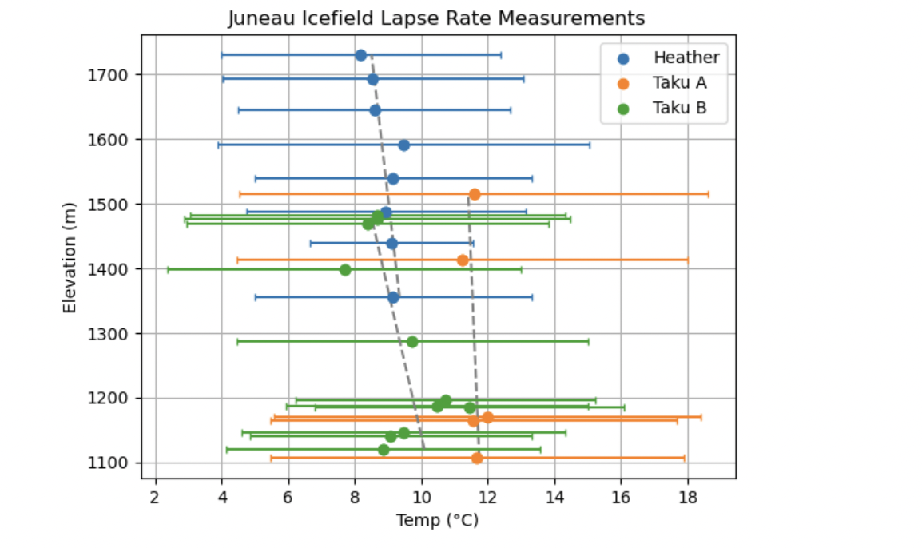
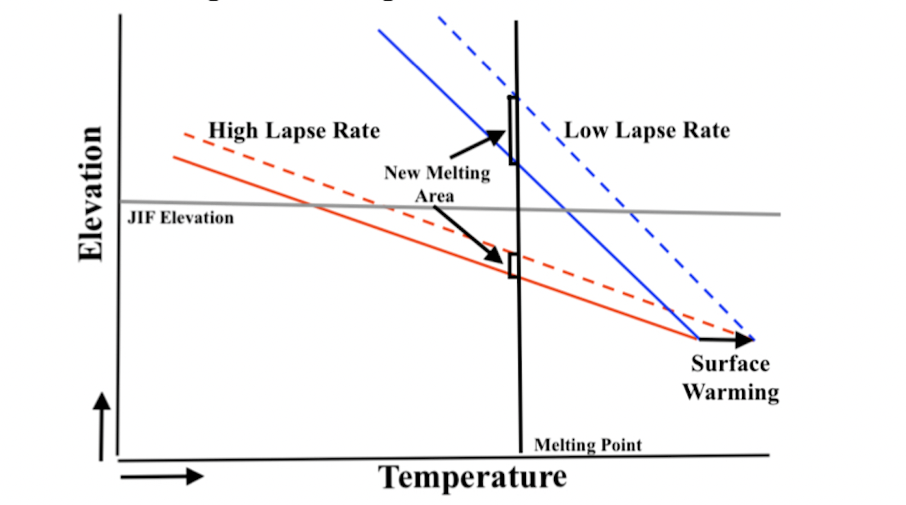
Spatial and Temporal Trends in Near Surface Lapse Rates on the Juneau Icefield
Adelle Welch (Bates College), Julius Mex (Ecole Normale Supérieure Paris), Leah Fleming (University of New Hampshire), Lia Salomon (Carleton College), Sophia Ludtke (Harvard College), Daniel Otto (University of Washington), Mira Berdahl (University of Washington)
SUMMARY:
METHODOLOGY:
CONCLUSIONS:
Near surface lapse rates are used to calculate glacial melting rates. Lapse rates are often assumed to be 5℃/km however they can vary greatly with topography making assumptions inaccurate. This study collected in situ air temperature measurements from transects on the Juneau Icefield and used data from Juneau Icefield Research Program (JIRP) weather stations to investigate seasonal and diurnal variability in near surface lapse rates.
BACKGROUND:
RESULTS:
Rates that have been used in calculating Juneau Icefield melt rates vary from 4℃/km to 6.5℃/km
ACKNOWLEDGEMENTS:

Slide 2
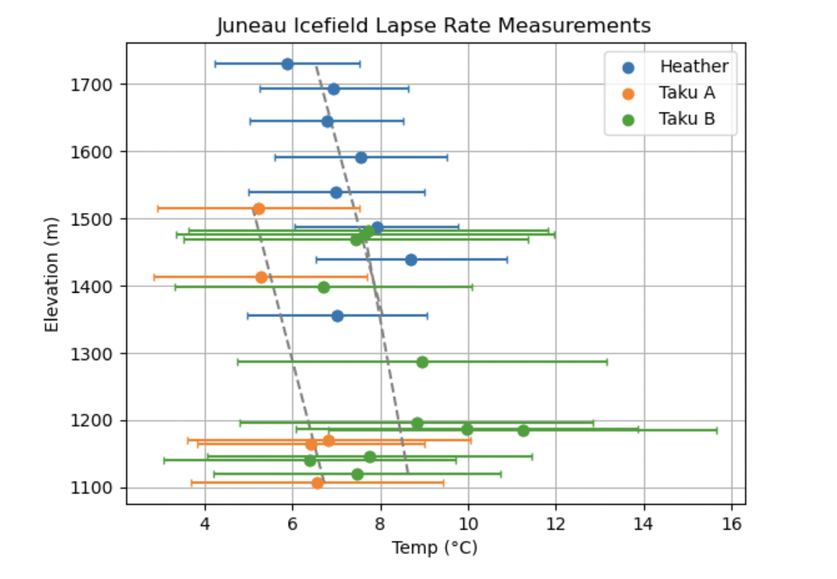
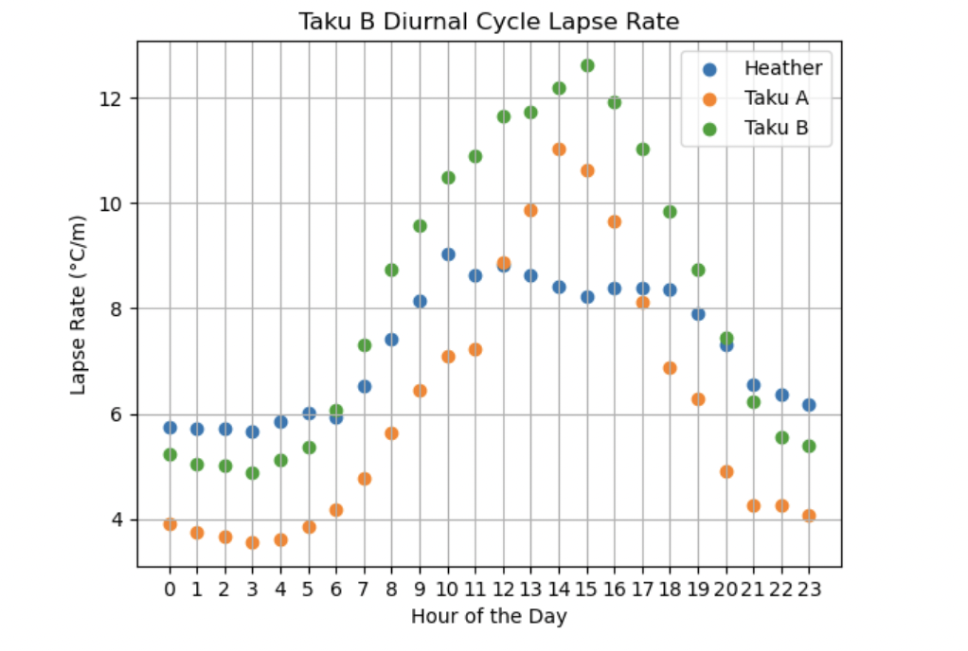
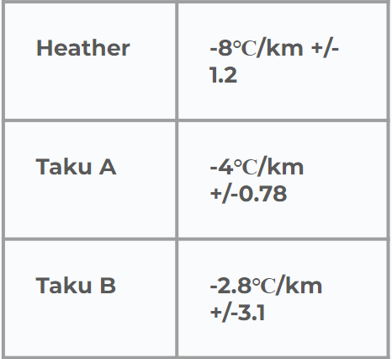
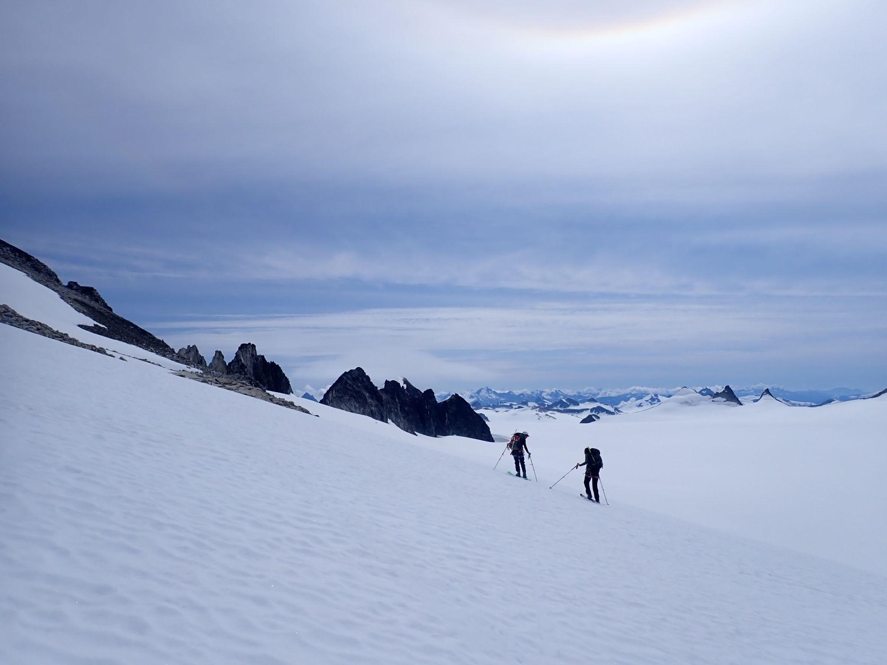
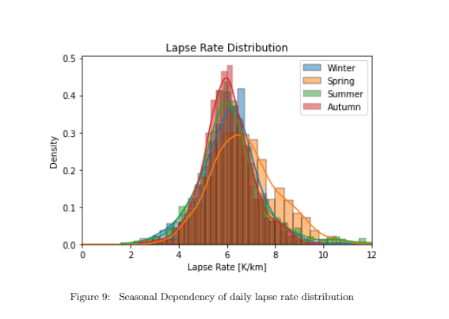
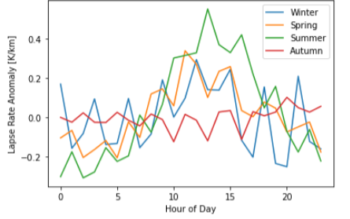
Spatial and Temporal Trends in Near Surface Lapse Rates on the Juneau Icefield
Adelle Welch (Bates College), Julius Mex (Ecole Normale Supérieure Paris), Leah Fleming (University of New Hampshire), Lia Salomon (Carleton College), Sophia Ludtke (Harvard College), Daniel Otto (University of Washington), Mira Berdahl (University of Washington)
SUMMARY:
METHODOLOGY:
CONCLUSIONS:
• Near surface lapse rates, used to calculate high-elevation temperatures, are often assigned a generic rate (e.g. 5℃/km) but can vary with topography • This study collected in situ air temperature measurements from Juneau Icefield transects and used data from Juneau Icefield Research Program (JIRP) weather stations to calculate lapse rates varying from 2.8℃/km to 8℃/km • Icefield lapse rates demonstrate a distinct diurnal cycle and seasonally dependent variability
Data Sources:
A.) iButtons temperature sensor data at three transects across the Juneau Icefield — referred to as Taku A, Taku B, and Heather (see Fig. 2) — over several days during July 2023 (Fig. 3)
• Lapse rates vary greatly (2.8℃/km to 8℃/km) through seasonal and diurnal cycles (Fig. 6).
• Variations include steeper lapse rates (Fig. 4 and Fig. 5) than used in previous Juneau Icefield mass balance studies (McNeil et al, 2020. O’Neel et al, 2019).
• Seasonal variations depend on slope, aspect, snow coverage, and local climate that is difficult to account for without high-resolution temperature data.
Figure 3a
BACKGROUND:
Figure 3b
• Spatially and temporally specific lapse rates are important in projecting future ice field sensitivity ⇒ steeper lapse rate exposes greater glacial area to melt as global temperatures warm (see Figure 1)
Figure 4. a) Juneau Icefield transect lapse rate measurements b) Diurnal cycle of lapse rates on the Juneau Icefield transects
Steeper lapse rate = greater vulnerability to glacial melt
Figure 3c
Figure 2
B.) Temperature measurements from Juneau Icefield historical weather station data (1998-2018)
Figure 5. a) Seasonal dependency of daily lapse rates on the Juneau Icefield b) Seasonal dependency of diurnal lapse rates on the Juneau Icefield
Figure 1
ACKNOWLEDGEMENTS:
• In regions without high-resolution temperature data, local data (ex. Juneau Airport data) can be extrapolated using a linear lapse rates • Yet, these linear lapse rates might neglect local factors such as slope, aspect, and surface properties
→ calculated a linear regression to determine lapse rate (℃/km)
Special thanks to Mira Berdal and Daniel Otto for their support, guidance and feedback throughout this project and to the Taku River Tlingit and Tagish people whose unceded land this research was conducted on.

Slide 3


Slide 4
LIST OF FIGURES:
Introductory lapse rate figure & data collection images, picture of ibuttons + taku b
Map —> weather station + transect locations
Our data:
Our stations —> Lapse rate averages & diurnal cycle
Weather stations —> overall distribution, annual cycle, daily cycle

Slide 8
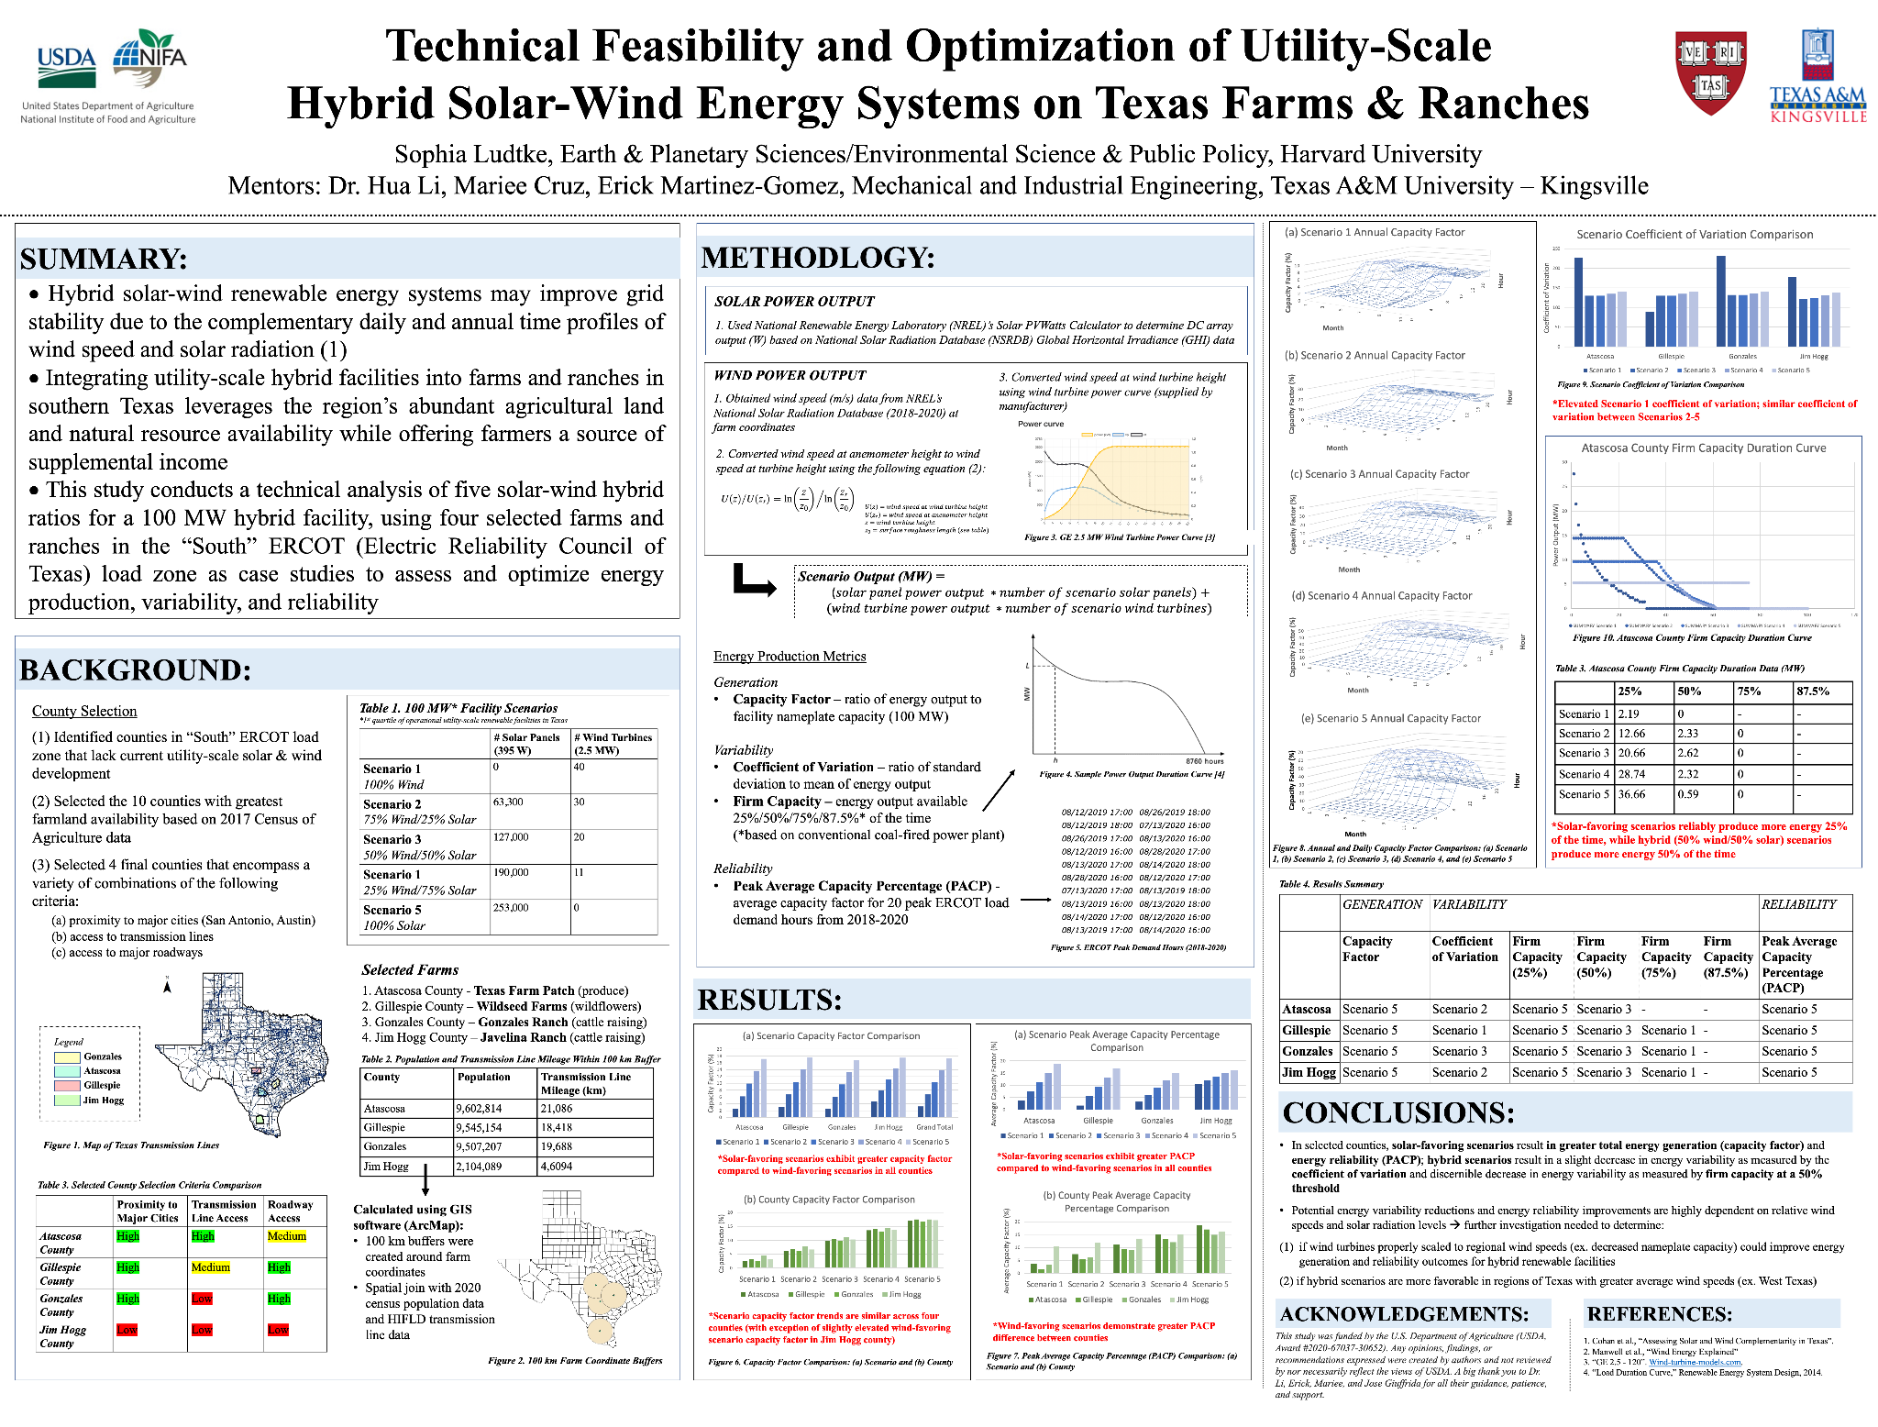
Notes:
Template

